Slide 1

Digital Flight Data Recorder
Rokas Cesiunas

Slide 2
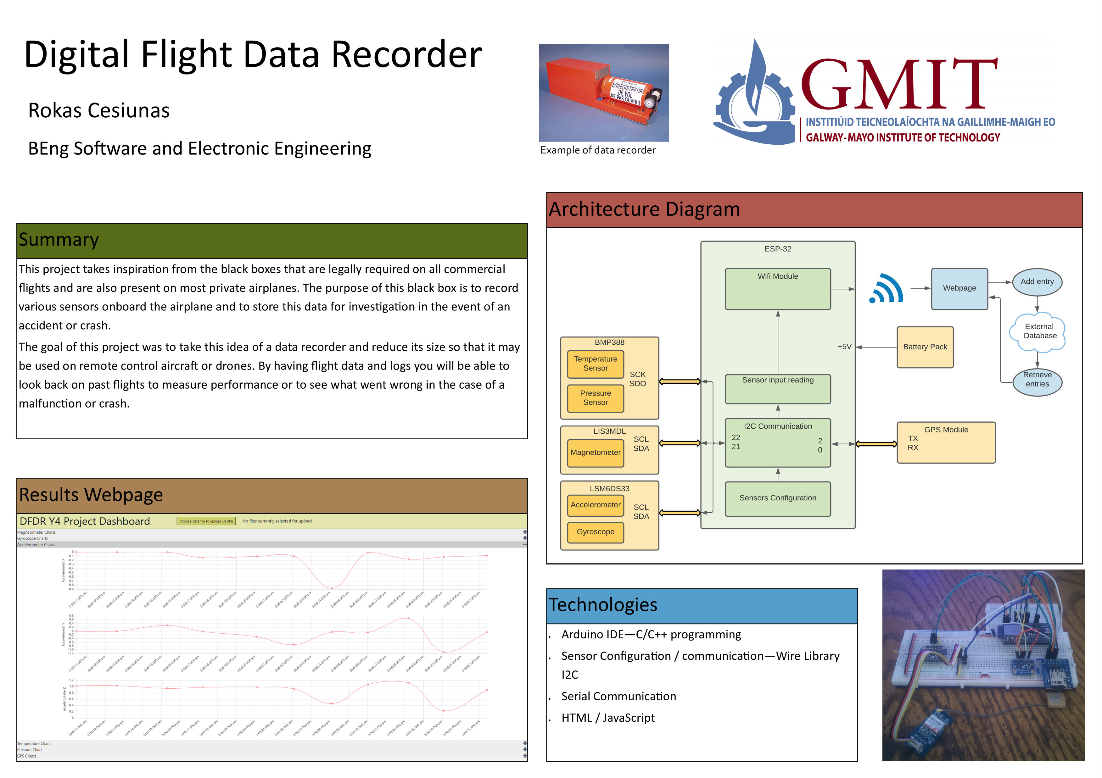

Slide 3
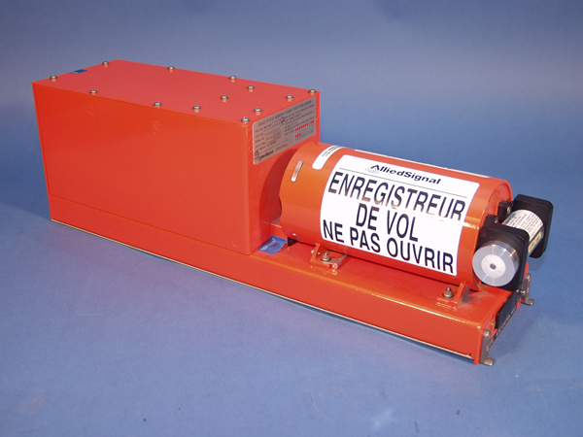
Flight recorder
Device used to record specific aircraft performance parameters
- collects data from up to 88 sensors
- stores data safely
Used by investigators in the event of a crash
- provides invaluable information about what happened
- information about malfunctions or errors

Slide 4
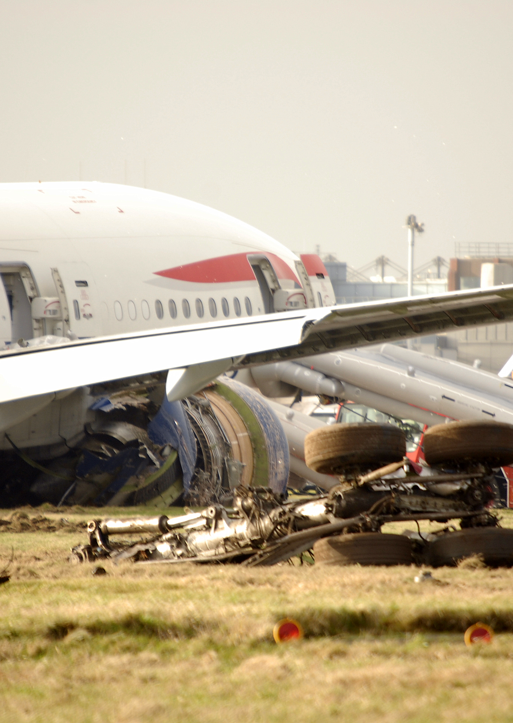
Survivability standards
Designed to withstand extreme conditions TSO C124a (DFDR)
- high temperature (1100°C for 30 mins)
- Impact shock ( 3,400g for 6.5 ms)
- submerged in sea water for 30 days

Slide 5
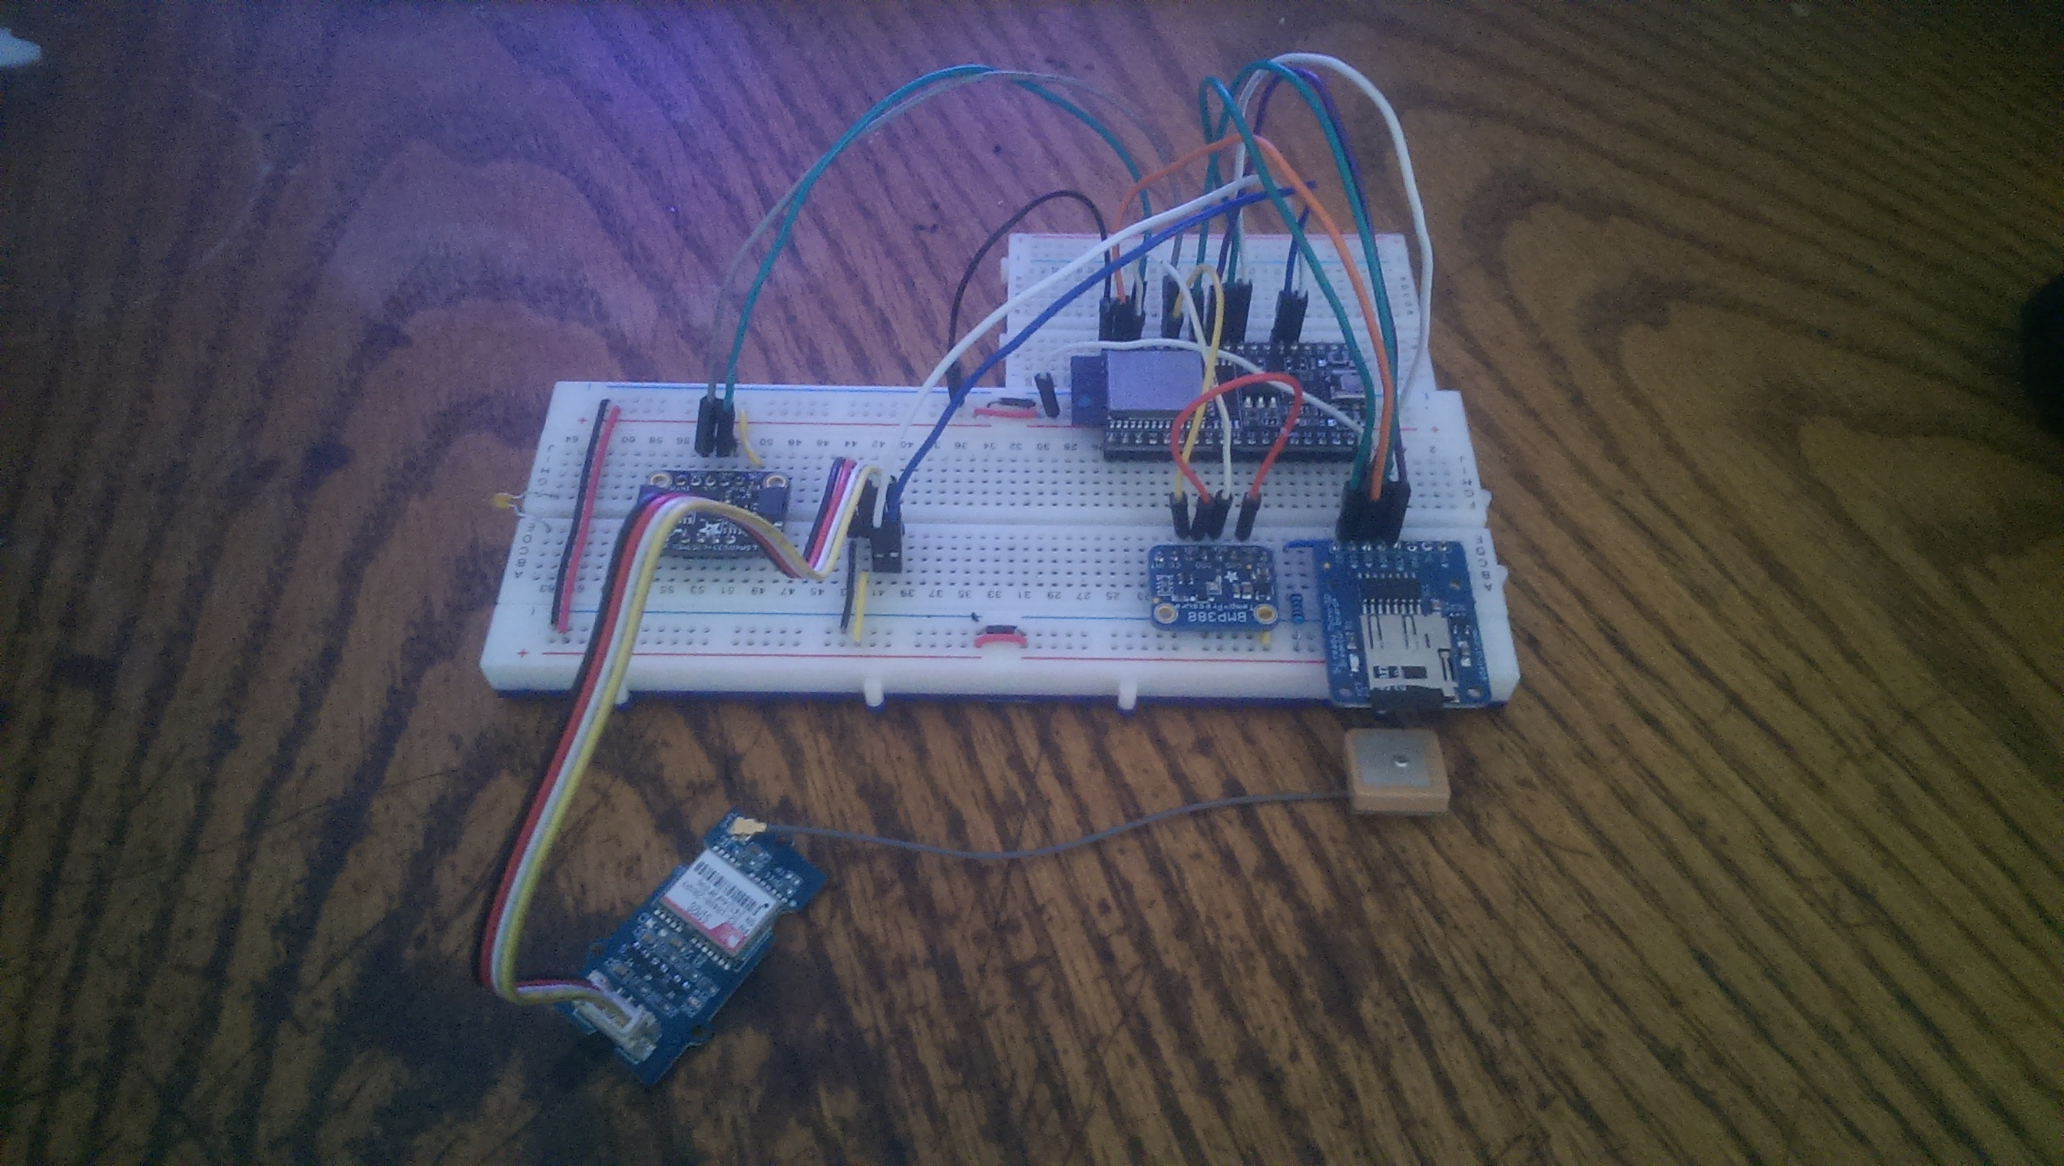
Digital Flight Data Recorder
ESP-32
Gyroscope, Accelerometer, Magnetometer
Pressure Sensor
GPS Receiver

Slide 6
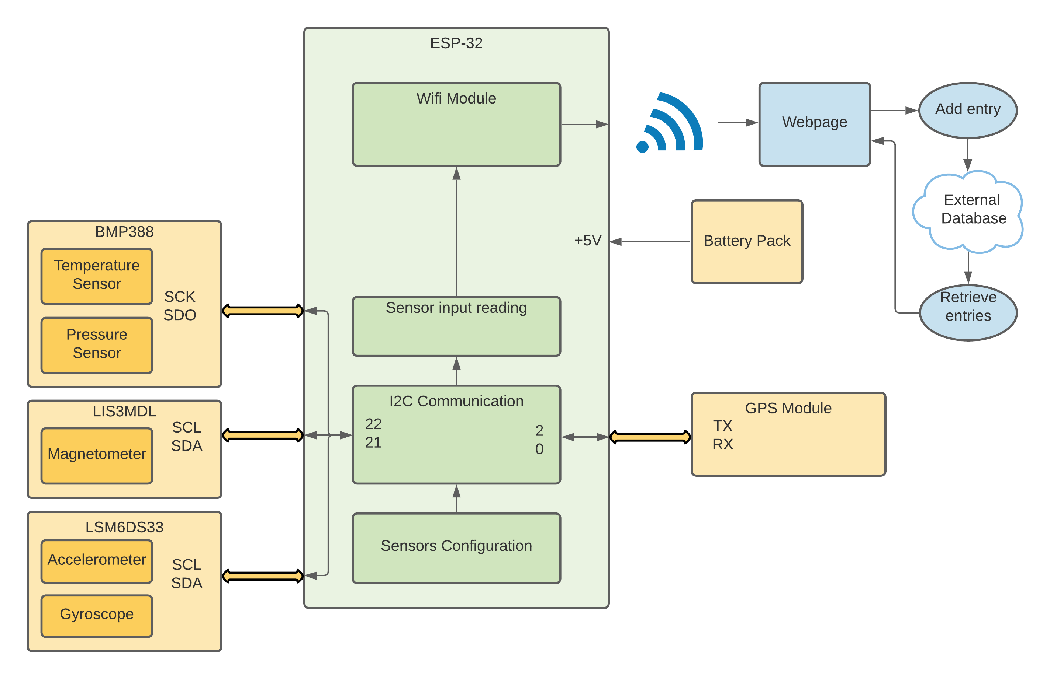
Architecture

Slide 7

Demonstration

